Slide 1
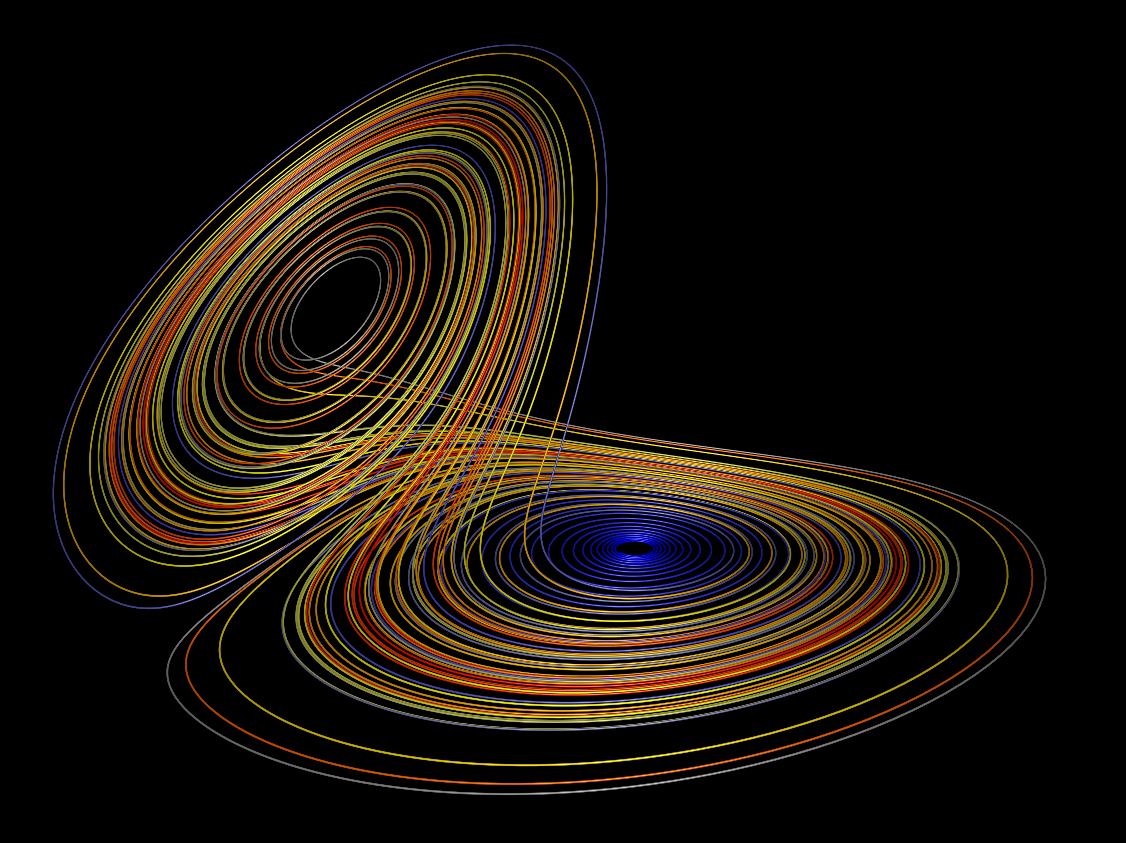
The Lorenz System
Jon Genty

Slide 2
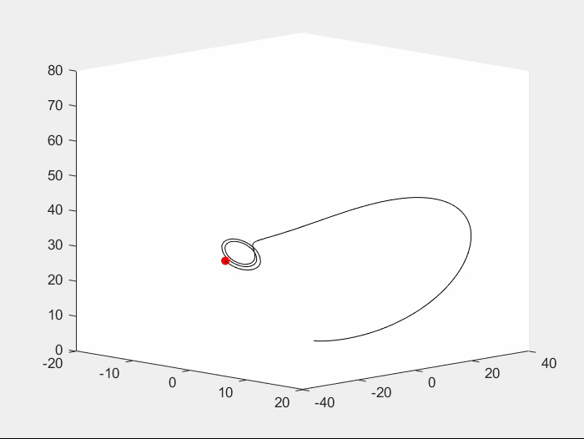
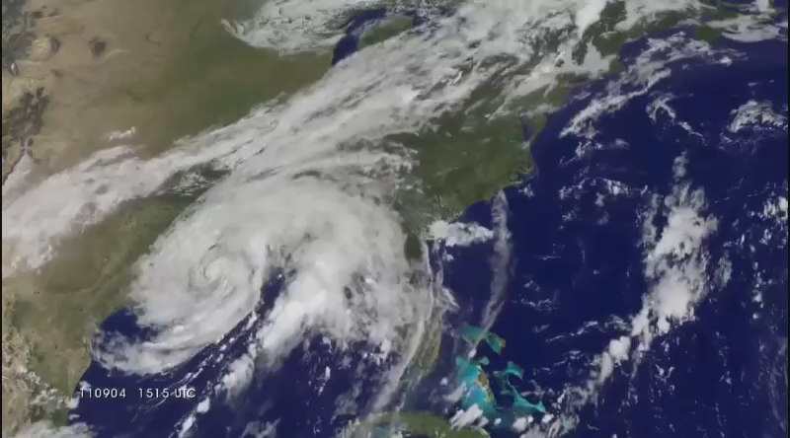

The Lorenz System
A system of ordinary nonlinear differential equations, developed by Edward Lorenz for the study of atmospheric convection
$\frac{dx}{dt}=σ\left(y−x\right)$
$\frac{dy}{dt}=x\left(ρ−z\right)−y$
$\frac{dz}{dt}=xy−βz$

Slide 3

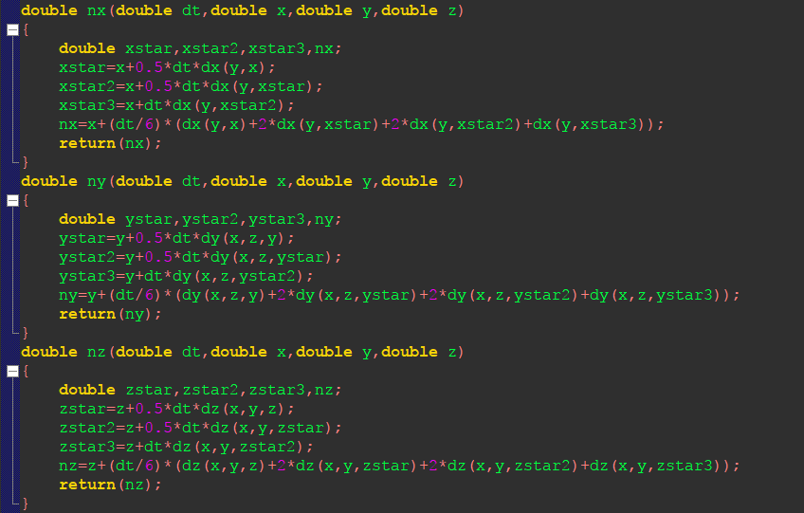
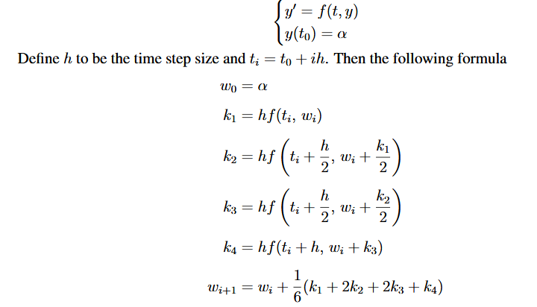
Solving
The Lorenz System cannot be solved analytically and as a result must be solved numerically
Runge-Kutta 4th Order Approximation

Slide 4
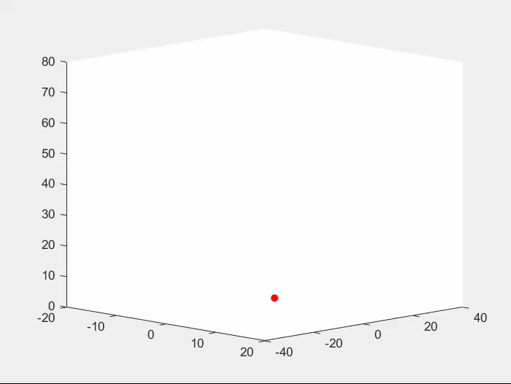
Cases
If ρ<1 then there is only one equilibrium point, located at the origin
This equilibrium corresponds to a lack of convection

Slide 5
Cases (cont.)
However, if ρ>1, then two critical points appear, suggesting steady convection

Slide 6
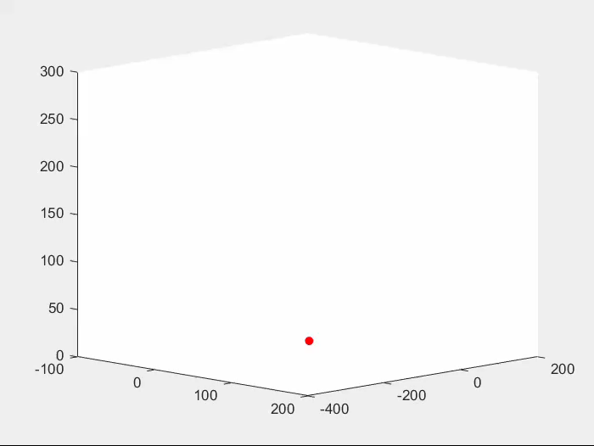
Cases (cont.)
If ρ=1, pitchfork bifurcation occurs
In a pitchfork bifurcation, the system transitions from one fixed point to three

Slide 7
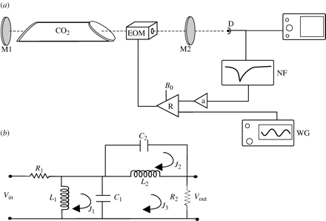
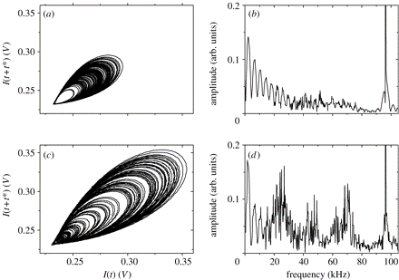

Additional Applications
Lasers – Laboratory set-up of a $CO_{2}$ laser with loss modulation that is partly due to an external driving force and partly due to a feedback loop including in the filter

Slide 8
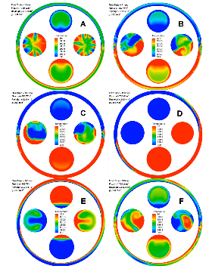
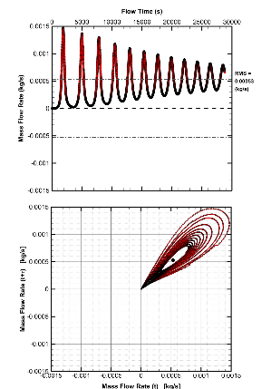
Additional Applications (cont.)
Thermosyphons – A method of passive heat exchange, based on natural convection, which circulates a fluid without the necessity of a mechanical pump

Slide 9
Sources
https://www.youtube.com/watch?v=aAJkLh76QnM
https://en.wikipedia.org/wiki/Lorenz_system
http://paulbourke.net/fractals/lorenz/
http://www.uvm.edu/~cdanfort/research/2015-louisos-ijhmt.pdf
https://math.okstate.edu/people/yqwang/teaching/math4513_fall11/Notes/rungekutta.pdf
https://en.wikipedia.org/wiki/Pitchfork_bifurcation

